Slide 1
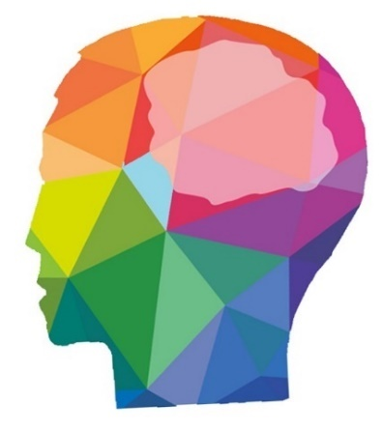
Problem
The problem faced is the “pressure” in our minds.
Thus this results in lack of concentration.
Further we don’t know what to do and what not to do.
PSYCHO
lighten up your mind

Slide 2
Team psycho
Asmita and Ashish : Idea,Presentation and Research work
Bhavesh and Ashok : Implementation model of Idea, Technical work and GUI.
We are four membered team :

Slide 3
IDEA
PROGRESS
Research has been done with data and still fetching.
UI is ready.
Technical Implementation on tone analyzer and chatbot is done.
The idea is to calculate pressure in minds of students,teens and adults(aged between 12 to 25)using our proposed technologies and then accordingly providing “what to do and what not to do” list.

Slide 4
Technologies used
Conversation assistant/Chatbot : It is a questioner system that provides a dialog interaction between the app and users.
Tone analyzer :Tone Analyzer uses linguistic analysis to detect emotional or language tones by written and speech text
Node.js : It is an open-source, cross-platform JavaScript run-time environment that executes JavaScript code server-side.

Slide 5
Competitors
Uniqueness
Pressure calculating and related apps on play store like :-
Anxiety free
The worry box
Inner balance
Calm
Breathe to relax
7 cups
many more…
We are different from these apps as these apps are connected to the users by physical means like finger print or any other whereas we are connected to the users through emotionally.

Slide 6
Recap
We are team psycho.
The idea is to calculate the pressure in mind felt by students and giving a score percentage of the pressure felt.
According to the calculated pressure,the guidline i.e “what to do and what not to do” list will be given to the user.
Also will be providing notifications of the events and activities going around to release pressure.
Thank you

